Slide 1

VALLURUPALLI NAGESWARA RAO VIGNANA JYOTHI INSTITUTE OF ENGINEERING AND TECHNOLOGY
Department of Computer Science and Engineering
Nearest-Neighbor Classifier KNN
MACHINE LEARNING
Dr. Kriti Ohri
Assistant Professor
Department of Computer Science and Engineering

Slide 2
K Nearest-Neighbor Classifier KNN

Slide 3
Nearest-Neighbor Classifier
lazy learner
instance base learner
Memory-Based Learning
k in kNN algorithm represents the number of nearest neighbor points which are voting for the new test data’s class.
Supervised and non parametric
Can be used for both classification and regression problems
kNN approximates the target function locally
Notes:
Supervised learning; xi and yi, come up with function f, instance based learning lazy learning
Instance , when we get training egs, we don’t learn the odel, but we only store.
No model is build apriori rather when it get test instances it process data and comes up with the result.
New instance; find the clostet instane, find y value and give to test instance
Find similar instances. Sone neigboring instances that are near. Distance should be known : Euclidean , cosine type of adat.
1)K nearest algo: 2 pahses traing phase: normally model is learnt, but we don’t in KNN, only save training example.
Stor ein datastructure, at prediction time: get test instance find k training instances closest to it.
It is called instance-based because it builds the hypotheses from the training instances. It is also known as memory-based learning or lazy-learning (because they delay processing until a new instance must be classified). The time complexity of this algorithm depends upon the size of training data

Slide 4
KNN called Instance Based Classifier
Instance-based learning methods simply store the training examples instead of learning explicit description of the target function. – Generalizing the examples is postponed until a new instance must be classified. – When a new instance is encountered, its relationship to the stored examples is examined in order to assign a target function value for the new instance.
• Instance-based learning includes nearest neighbor, locally weighted regression and case-based reasoning methods.
• Instance-based methods are sometimes referred to as lazy learning methods because they delay processing until a new instance must be classified.
• A key advantage of lazy learning is that instead of estimating the target function once for the entire instance space, these methods can estimate it locally and differently for each new instance to be classified.

Slide 5
Nearest neighbor Classification…
k-NN classifiers are lazy learners
It does not build models explicitly
Unlike eager learners such as decision tree induction and rule-based systems

Slide 6
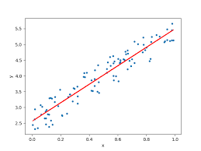
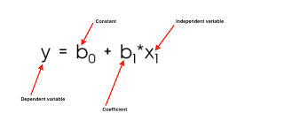
Model Based Learning
Instance Based Learning
x | y
6 | 2
7 | 5
88 | 56
x | y
6 | 2
7 | 5
88 | 56
Storage
prediction
Whenever prediction comes build the model and find the results

Slide 7
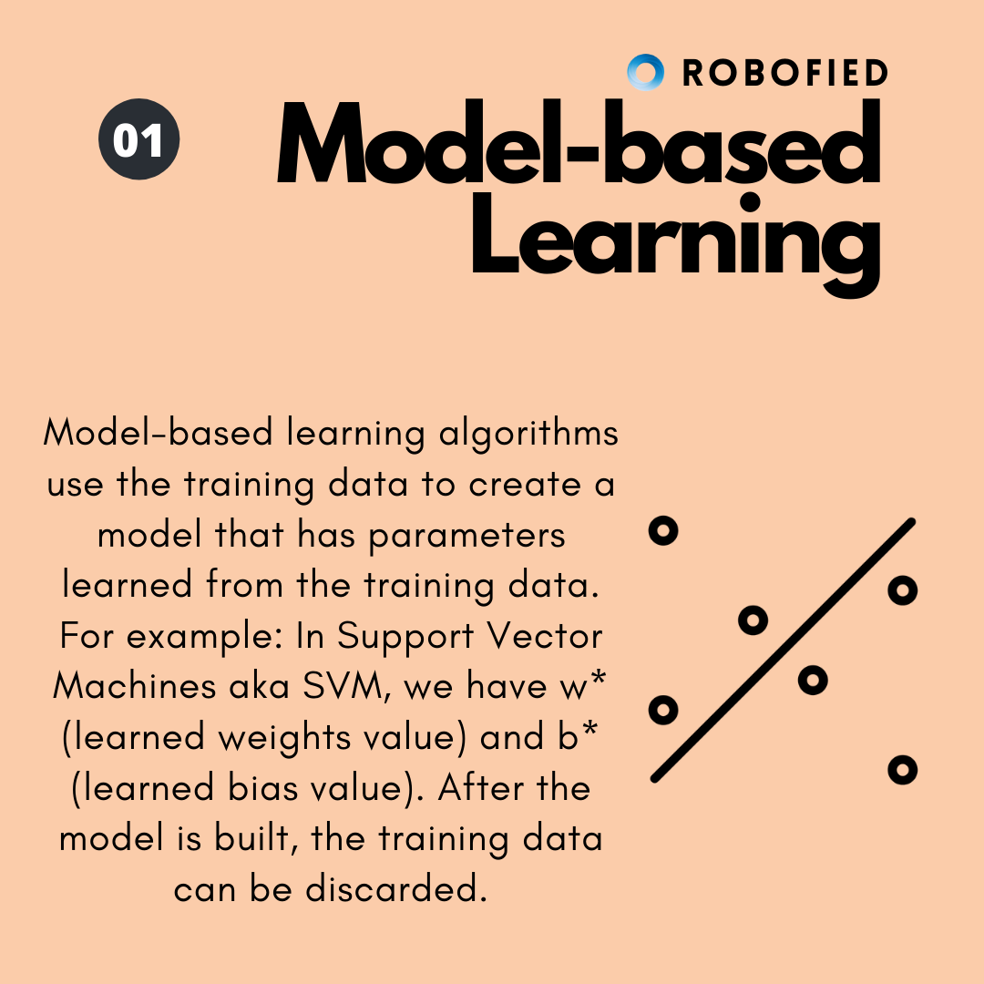
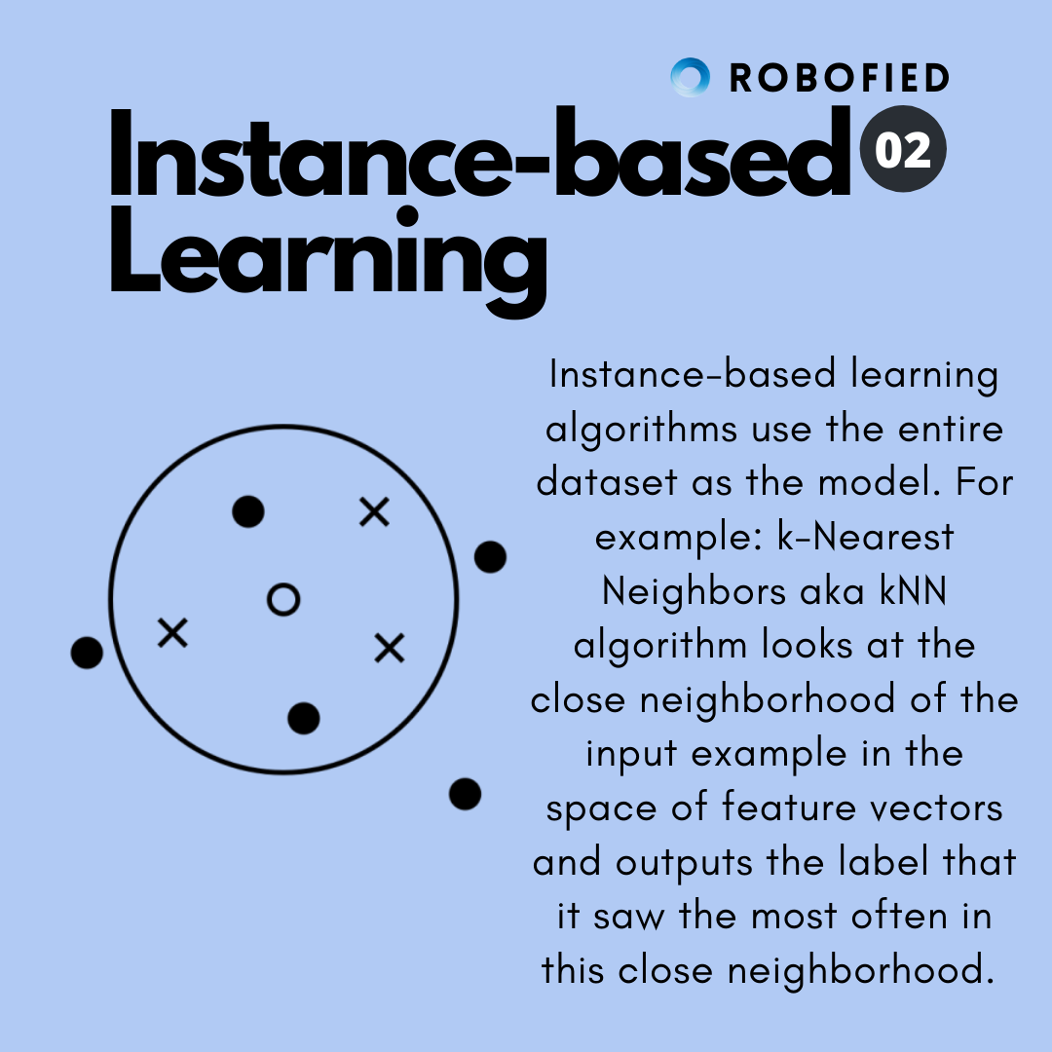

Slide 8
Instance-Based Classifiers
Set of Stored Cases
Store the training records
Use training records to predict the class label of unseen cases
Atr1 | ……... | AtrN | Class
 |  |  | A
 |  |  | B
 |  |  | B
 |  |  | C
 |  |  | A
 |  |  | C
 |  |  | B
Unseen Case
Atr1 | ……... | AtrN

Slide 9
What is KNN Algorithm?
K nearest neighbors or KNN Algorithm is a simple algorithm which uses the entire dataset in its training phase. Whenever a prediction is required for an unseen data instance, it searches through the entire training dataset for k-most similar instances and the data with the most similar instance is finally returned as the prediction.
kNN is often used in search applications where you are looking for similar items, like find items similar to this one.
Algorithm suggests that if you’re similar to your neighbours, then you are one of them. For example, if apple looks more similar to peach, pear, and cherry (fruits) than monkey, cat or a rat (animals), then most likely apple is a fruit.

Slide 10
How does a KNN Algorithm work?
The k-nearest neighbors algorithm uses a very simple approach to perform classification. When tested with a new example, it looks through the training data and finds the k training examples that are closest to the new example. It then assigns the most common class label (among those k-training examples) to the test example.

Slide 11
What does ‘k’ in kNN Algorithm represent?
k in kNN algorithm represents the number of nearest neighbor points which are voting for the new test data’s class.
If k=1, then test examples are given the same label as the closest example in the training set.
If k=3, the labels of the three closest classes are checked and the most common (i.e., occurring at least twice) label is assigned, and so on for larger k’s.

Slide 12

Nearest-Neighbor Classifiers
Unknown record
l Requires three things
The set of stored records
Distance Metric to compute distance between records
The value of k, the number of nearest neighbors to retrieve
l To classify an unknown record:
Compute distance to other training records
Identify k nearest neighbors
Use class labels of nearest neighbors to determine the class label of unknown record (e.g., by taking majority vote)

Slide 13

Definition of Nearest Neighbor
X
X
X
(a) 1-nearest neighbor (b) 2-nearest neighbor (c) 3-nearest neighbor
K-nearest neighbors of a record x are data points that have the k smallest distance to x

Slide 14
In the K-Nearest Neighbors (KNN) algorithm, the classification class for a given data point is determined by the majority vote among its K nearest neighbors.
When K=2 in KNN, the algorithm will consider the 2 closest data points to the query point. The classification class will depend on the labels of these 2 neighbors:
If both neighbors belong to the same class, the query point will be classified as that class.
If the two neighbors belong to different classes, the classification becomes ambiguous. In such cases, the algorithm may either:
Use a tie-breaking mechanism, such as assigning the query point to the class of the nearest neighbor (closer of the two).
Randomly assign the class.
Not classify the point and mark it as ambiguous.
Using an odd value for K is generally preferred to avoid such ties.

Slide 15
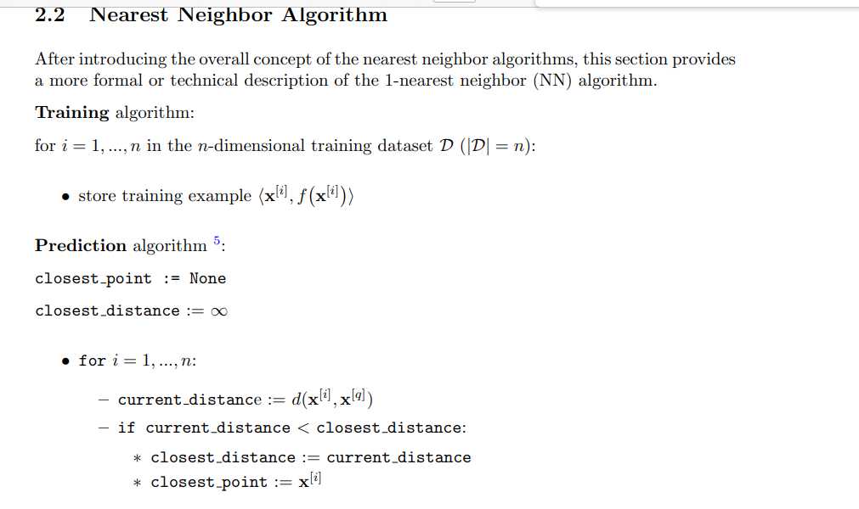

Slide 16
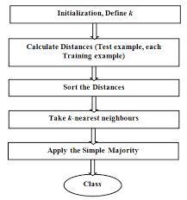
KNN algorithmic steps

Slide 17
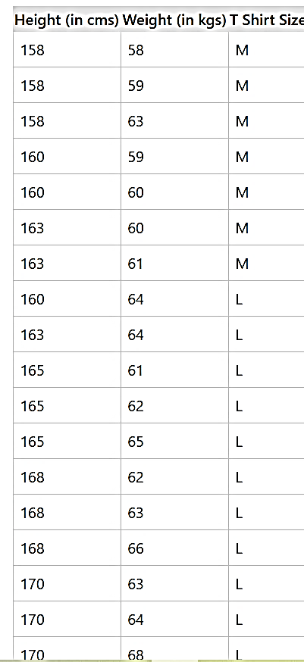
kNN Algorithm Manual Implementation
Suppose we have height and weight and its corresponding T-shirt size of several customers. Your task is to predict the T-shirt size of Anna, whose height is 161cm and her weight is 61kg.

Slide 18
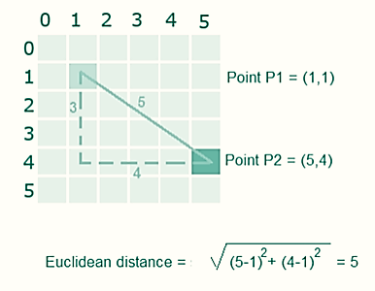
Step1: Calculate the Euclidean distance between the new point and the existing points
For example, Euclidean distance between point P1(1,1) and P2(5,4) is

Slide 19
k-Nearest Neighbor Learning
The nearest neighbors of an instance are defined in terms of Euclidean distance.
Euclidean distance between the instances xi = <xi1,…,xin> and xj = <xj1,…,xjn> are:
d (xi, xj ) = ∑(xir − xjr )²
r =1
n

Slide 20
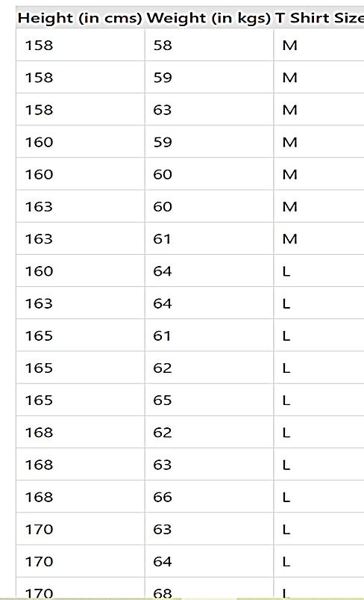
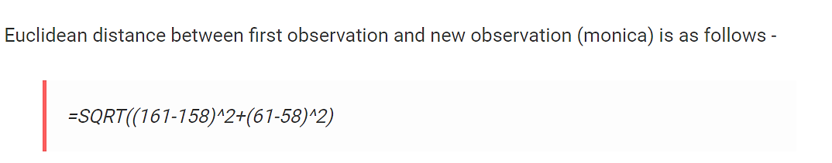
New customer named ‘Anna' has height 161cm and weight 61kg. Predict the T shirt size

Slide 21
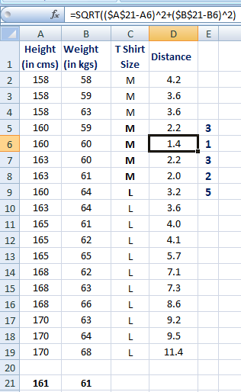
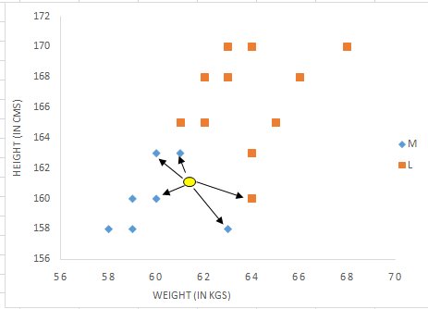
Step 2: Choose the value of K and select K neighbors closet to the new point. Suppose k=5
161cm and weight 61kg

Slide 22
Step 3: Count the votes of all the K neighbors / Predicting Values
Since for K = 5, we have 4 Tshirts of size M, therefore according to the kNN Algorithm, Anna of height 161 cm and weight, 61kg will fit into a Tshirt of size M.

Slide 23
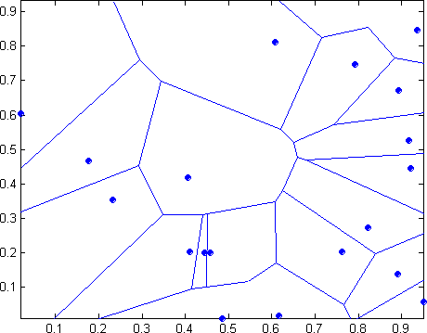
1 nearest-neighbor
Voronoi Diagram
Test point

Slide 24
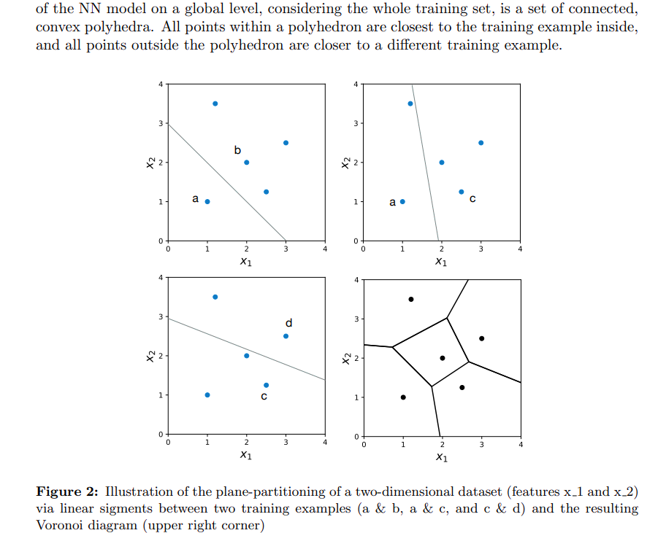

Slide 25
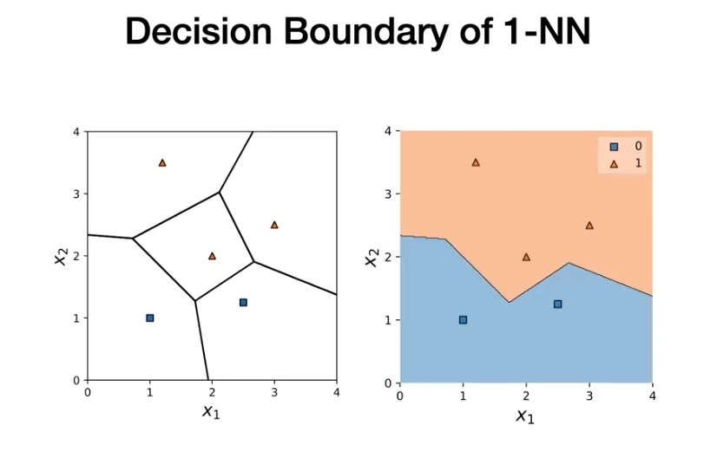

Slide 26
This partitioning of regions on a plane in 2D is also called “Voronoi diagram” or Voronoi tessellation. (You may remember from geometry classes that given a discrete set of points, a Voronoi diagram can also be obtained by a process known as Delaunay triangulation by connecting the centers of the circumcircles.) While each linear segment is equidistant from two different training examples, a vertex (or node) in the Voronoi diagram is equidistant to three training examples. Then, to draw the decision boundary of a two-dimensional nearest neighbor classifier, we take the union of the pair-wise decision boundaries of instances of the same class.

Slide 27
The KNN classification algorithm (important)
Let k be the number of nearest neighbors and D be the set of training examples.
for each test example z = (x’,y’) do
Compute d(x’,x), the distance between z and every example, (x,y) ϵ D
Select D_{z} ⊆ D, the set of k closest training examples to z.
4. Predict the majority class
5. end for

Slide 28
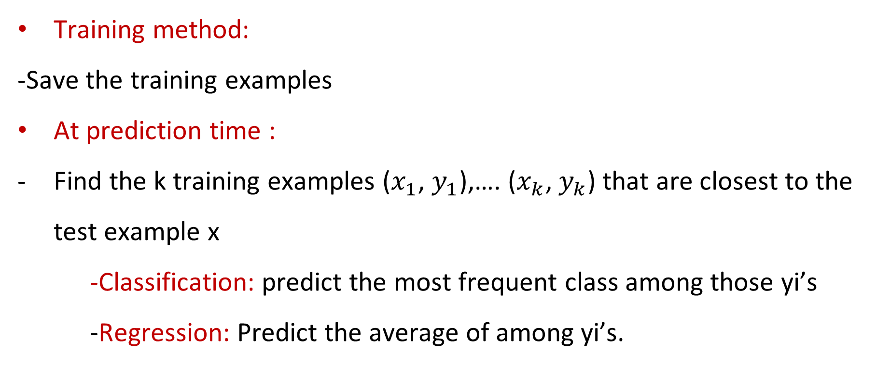
Basic K –nearest Neighbor classification (important)
Training method:
-Save the training examples
At prediction time :
Find the k training examples ($x_{1}$, $y_{1}$),…. ($x_{k}$, $y_{k}$) that are closest to the test example x
-Classification: predict the most frequent class among those yi’s
-Regression: Predict the average of among yi’s.

Slide 29
Certain points to be addressed in KNN
1. Choosing a value of K
2. How to measure closeness./similarity- What type distance function to use . We can use Euclidean distance function as one of the metric, but other distance functions are possible.

Slide 30
Implementation of kNN Algorithm using Python
Handling the data
Calculate the distance
Find k nearest point
Predict the class
Check the accuracy

Slide 31
Instance Based Classifier
Nearest neighbor
Uses k “closest” points (nearest neighbors) for performing classification

Slide 32
1-Nearest Neighbor works well if :
No input attribute has noise
No class noise
No overlap of classes
When k=1 we can learn complex functions (sharp class boundaries)

Slide 33
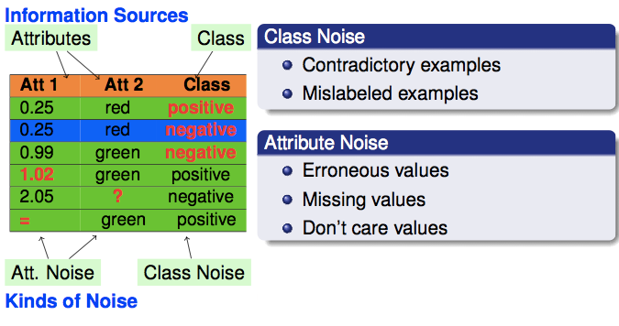

Slide 34
When to use K larger than 1
Noise in the attributes
Noise in class labels
Classes may partially overlap
When we use K which is large , we get smooth classifier.

Slide 35
Euclidean Distance
We can use Euclidean distance under the following assumptions-
Equal Weights to all attributes
If the scale of the attributes are similar
Variance and range is similar among various attributes.
Classes are spherical in shape
No noise
But if all attributes are not equally important or the attributes have different scale, or you have noise So, a normal Euclidean distance may not work.

Slide 36
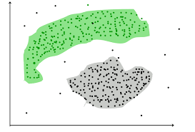
Non spherical classes

Slide 37
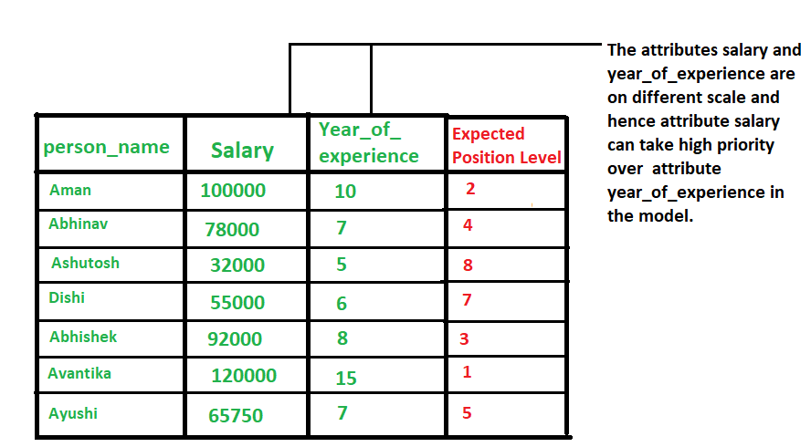
Different scale attributes

Slide 38
Scaling issues
Scaling issues
Attributes may have to be scaled to prevent distance measures from being dominated by one of the attributes
Example:
height of a person may vary from 1.5m to 1.8m
weight of a person may vary from 60 KG to 100KG
income of a person may vary from Rs10K to Rs 2 Lakh
Solution is standardizing data

Slide 39
Standardizing the data
To avoid this dependence on the choice of measurement units, one has the option of standardizing the data
This converts the original measurements to unitless variables

Slide 40
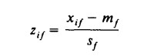
Standardizing the data
The standardized measurements are defined by and sometimes called z-scores
They are unitless because both the numerator and the denominator are expressed in same units
mean absolute deviation is equal to1 and mean 0 after calculating z score for each attribute

Slide 41
Solution for the limitation of Euclidean distance
Use larger K
Weighted Euclidean distance as a distance measure

Slide 42
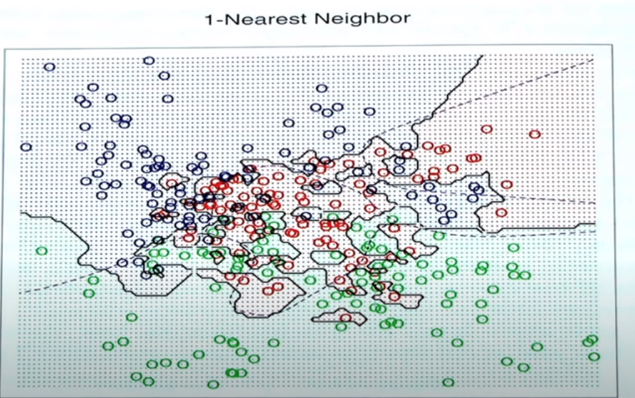
Small value of k, it captures fine structures of the problem space better, if training set is small

Slide 43
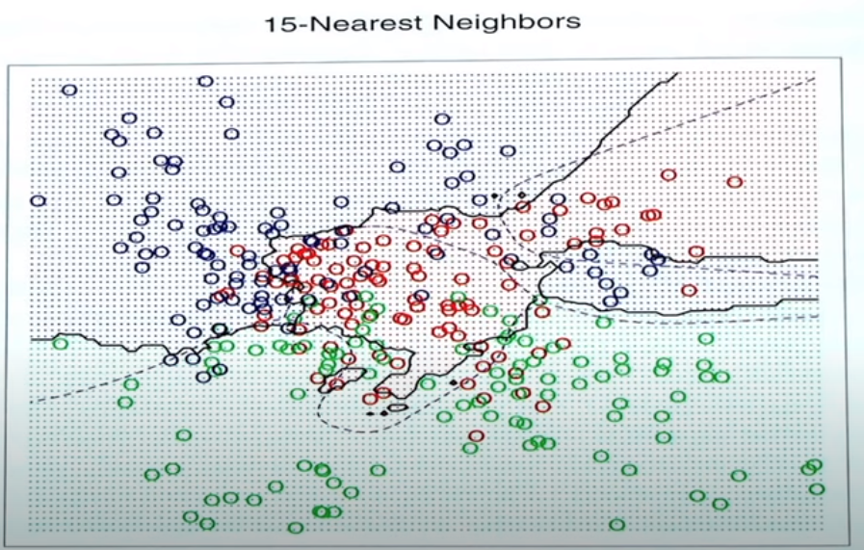
classes are smoother

Slide 44
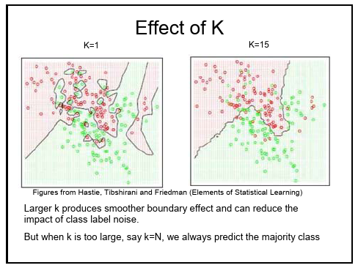
Notes:
Smaller value of k captures very small fine structure of problem space

Slide 45
More on K
At this point, you’re probably wondering how to pick the variable K and what its effects are on your classifier. Well, like most machine learning algorithms, the K in KNN is a hyperparameter that you, as a designer, must pick in order to get the best possible fit for the data set. Intuitively, you can think of K as controlling the shape of the decision boundary .When K is small, we are restraining the region of a given prediction and forcing our classifier to be “more blind” to the overall distribution. A small value for K provides the most flexible fit, which will have low bias but high variance. Graphically, our decision boundary will be more jagged. On the other hand, a higher K averages more voters in each prediction and hence is more resilient to outliers. Larger values of K will have smoother decision boundaries which means lower variance but increased bias.

Slide 46
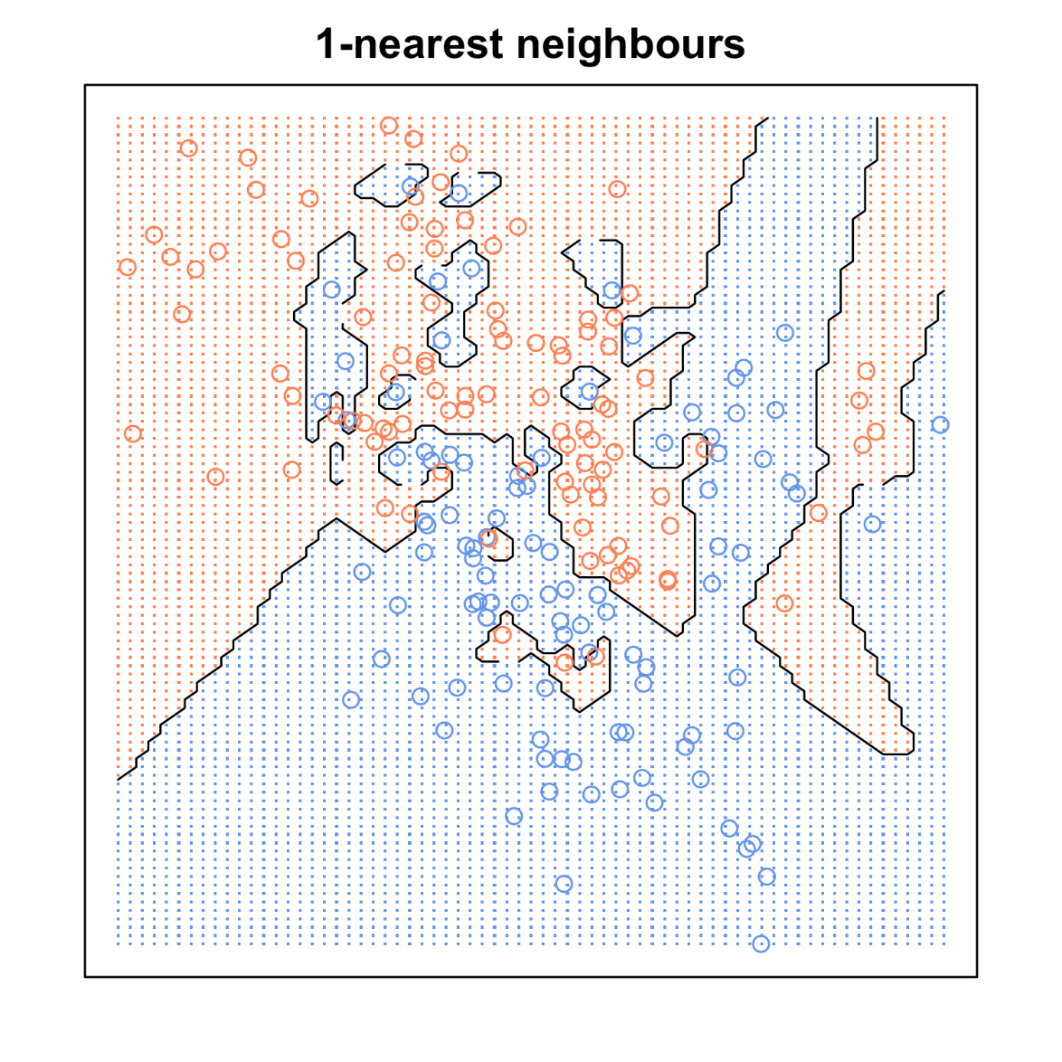
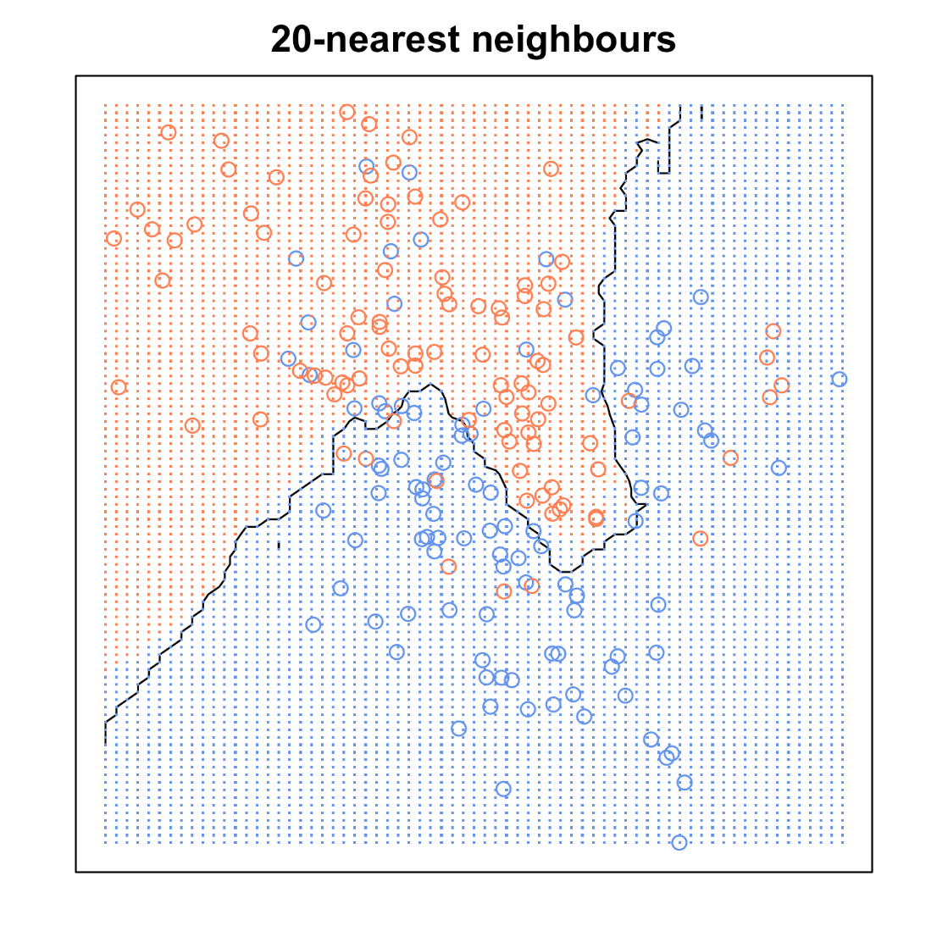

Slide 47
Large k:
– less sensitive to noise (particularly class noise)
– larger training sets allow larger values of k
-captures smooth structure of problem space better
Small k:
– captures fine structure of problem space better
– may be necessary with small training sets
• Balance must be struck between large and small k

Slide 48
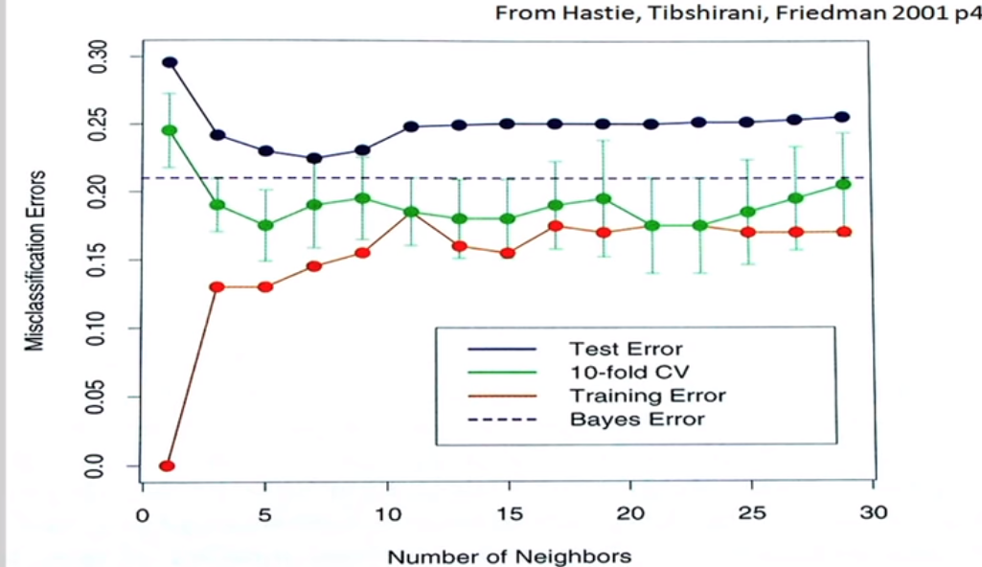

Slide 49
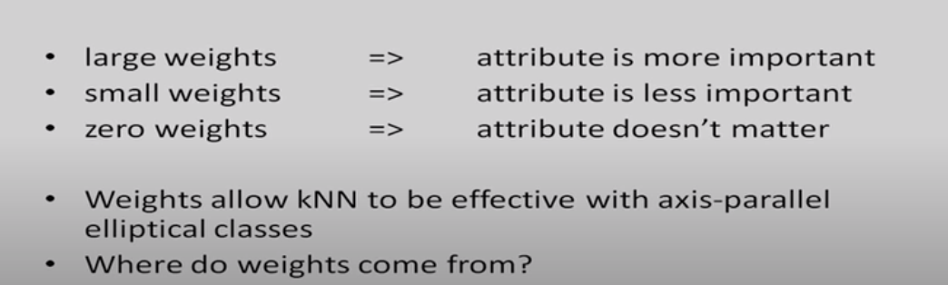
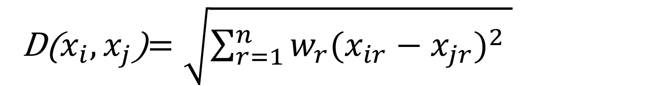
Weighted Euclidian distance
D($x_{i}, x_{j}$)$=\sqrt{\sum_{r=1}^{n}{w_{r}{(x_{ir}−x_{jr})}^{2} }}$
We have different weights for different attributes. So, for those attributes which are more important for the particular classification, we can use larger weights and for less important attributes, we can use smaller weights.

Slide 50
Nearest Neighbor Classification…
Choosing the value of k:
If k is too small, sensitive to noise points
If k is too large, neighborhood may include points from other classes
X

Slide 51
Weighted KNN
Weighted kNN is a modified version of k nearest neighbors. One of the many issues that affect the performance of the kNN algorithm is the choice of the hyperparameter k. If k is too small, the algorithm would be more sensitive to outliers. If k is too large, then the neighborhood may include too many points from other classes. Another issue is the approach to combining the class labels. The simplest method is to take the majority vote, but this can be a problem if the nearest neighbors vary widely in their distance and the closest neighbors more reliably indicate the class of the object.

Slide 52
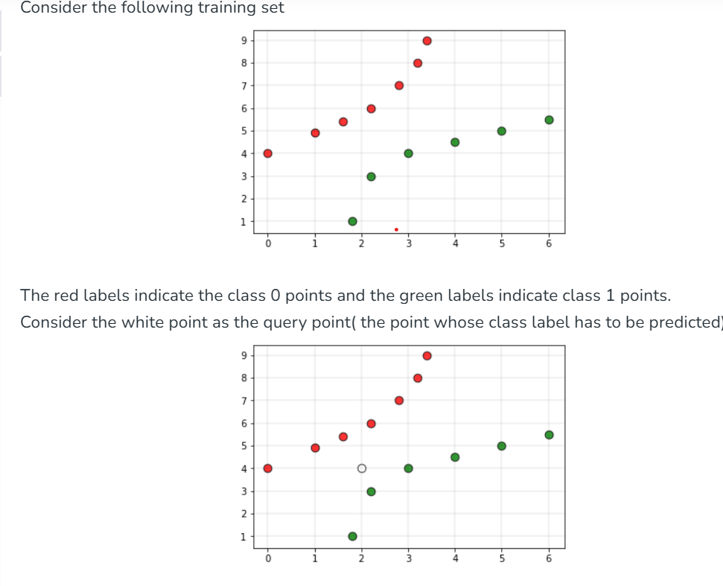

Slide 53
If we give the above dataset to a kNN based classifier, then the classifier would declare the query point to belong to the class 0. But in the plot, it is clear that the point is more closer to the class 1 points compared to the class 0 points. To overcome this disadvantage, weighted kNN is used. In weighted kNN, the nearest k points are given a weight using a function called as the kernel function. The intuition behind weighted kNN, is to give more weight to the points which are nearby and less weight to the points which are farther away. Any function can be used as a kernel function for the weighted knn classifier whose value decreases as the distance increases. The simple function which is used is the inverse distance function.

Slide 54
In instance based learning given the test data instance we have to find out the nearby instances for this we need a distance function. This distance function is computed in term of the features. If the number of features is large there is a problem, because the distance that you get may not be representative of the actual distance. So, this is a reason why feature reduction becomes important.

Slide 55
Common Use Cases of kNN
One area where k-nearest neighbors models are still commonly and successfully being used is in the intersection between computer vision, pattern classification, and biometrics (e.g., to make predictions based on extracted geometrical features ). Other common use cases include recommender systems (via collaborative filtering ) and outlier detection, face detection,
Pattern recognition

Slide 56
Curse of Dimensionality
The kNN algorithm is particularly susceptible to the curse of dimensionality. In machine learning, the curse of dimensionality refers to scenarios with a fixed size of training examples but an increasing number of dimensions and range of feature values in each dimension in a high-dimensional feature space. In kNN an increasing number of dimensions becomes increasingly problematic because the more dimensions we add, the larger the volume in the hyperspace needs to be to capture a fixed number of neighbors. As the volume grows larger and larger, the “neighbors” become less and less “similar” to the query point as they are now all relatively distant from the query point considering all different dimensions that are included when computing the pairwise distances.

Slide 57
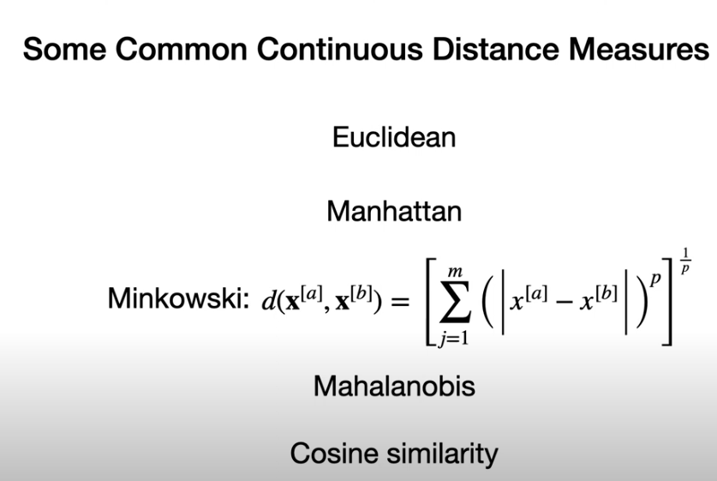

Slide 58
Thank You

